Slide 1
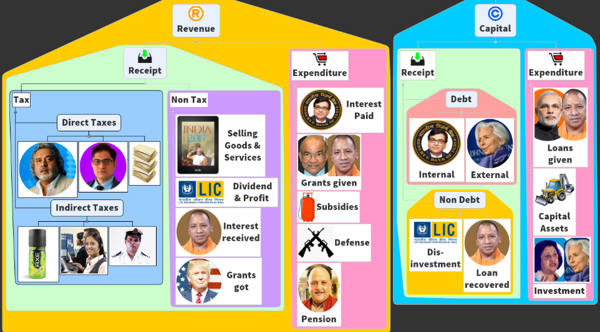
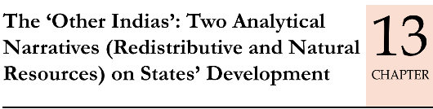
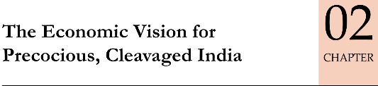
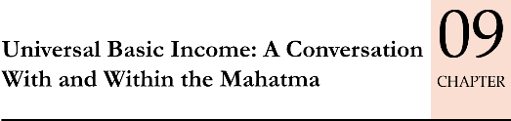
BES172: Survey Chapters related to Subsidies, Grants, and Planning
as such, these chapters written with Mains flavor but need to have an overview, for Prelims: assertion-reasoning, cause-consequence, definition type MCQs.

Slide 2
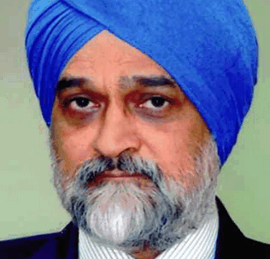
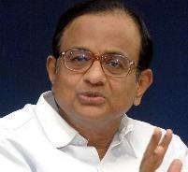
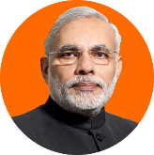
Multiple schemes + Bureaucratic machinery Empire within empires=> duplication of man, material and money resources
UPA
147 CSS
2013: UPA-II
Reduced to 66
2014: Modi
Modi added 6
=72
2015: Modi
Niti Ayog Shivraj Panel
Latest 28 (2017)

Slide 3
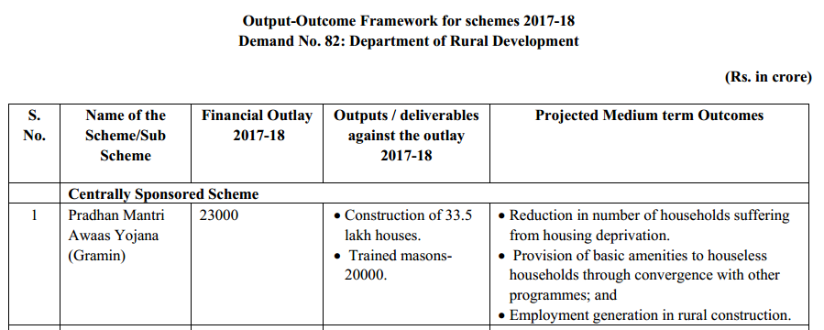
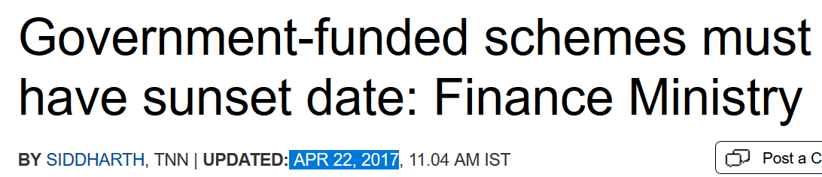
Budget 2017: Announced Output-Outcome Framework.
Before
Budget: Financial outlays for each ministry e.g. Rural Development Ministry- MNREGA: __cr.
After Budget 2017
Outlay: $ given
Output: quantitative things.
Later on Ministry presented their achievements.
Outcome: qualitative things.

Slide 4
“Output Outcome framework document” which was submitted with budget 2017, contains which of the following data:
Outlay of the amount allotted in a scheme
Output in qualitative terms
Outcome in quantitative terms
All of above.

Slide 5
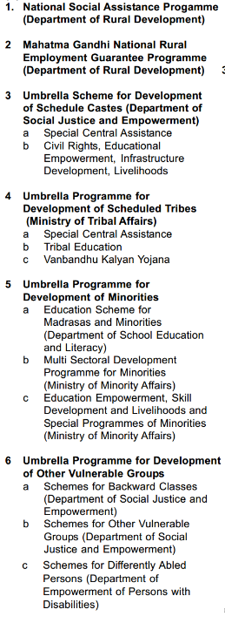
Out of 28 CSS: Core of the Core Schemes (6)
Cost Sharing: Existing formula of UPA-II
Eg. Widow Pension
Union: Rs.200
State: Rs. 200/>
Ref: Fin-inclu lecture for more.
Union to bear*
Wages:100%
Material:75%
Admin.: 6%
---
Budget’17: 48k cr.
NSoAP
MNREGA
SC
ST
Minorities
OBC,PH, Vuln
Rural Development Ministry
Read list on left side carefully, which dept looks after what.

Slide 6
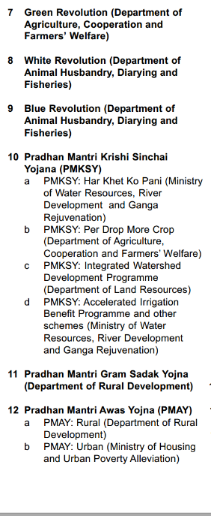
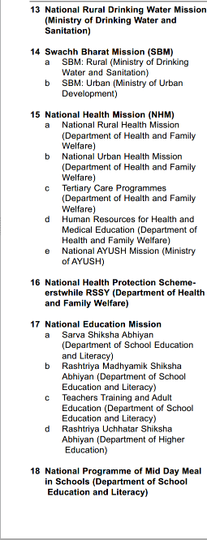
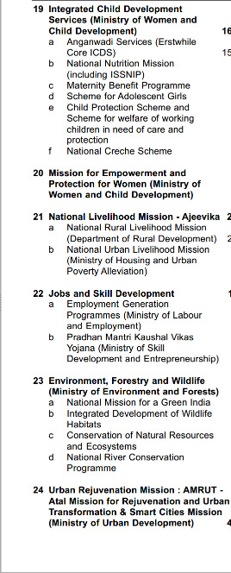
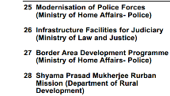
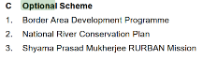
Total CSS (28)- Core of the Core (6)= 22 Core Schemes.
Earlier (2016)
Individual scheme’s salient features we’ll see in appropriate pillars.
e.g. urban dev and rural dev = 17”5” infra.
Read list on left side carefully, which dept looks after what.

Slide 7
Which of the following is not a core scheme for Modi Government?
a. Van Bandhu Kalyan Yojana
b. Shyama Prasad Mukherjee Rurban Mission
c. Sarva Shiksha Abhiyan
d. National Rural Health Mission

Slide 8
CSS restructured
What is this “Special category states”?
Type
Core of the core
Core
Schemes
06
Special
Optional
22
General
Existing
Existing
90-10
60-40
80-20
50-50
03

Slide 9
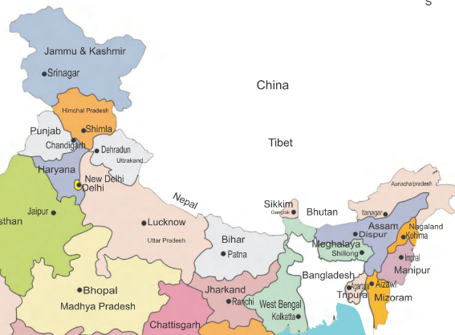
Started in ’69 (5th FC) : Special category states? 8+3=11
8 North East
Arunachal Pradesh
Assam
Manipur
Meghalaya
Mizoram
Nagaland
Sikkim
Tripura
3 Himalayan States
Uttarakhand
Himachal Pradesh
Jammu and Kashmir
HW: Map based MCQs
15 Pages -> 10 slides

Slide 10
Special Category States Parameters
Low population density/sizeable share of tribal population <NE: professional tax, VAT income ▼>;
Non-viable state finances. (e.g. J&K because terrorism: tourism ▼, Manipur “blockade”: factory ▼)
Economic and infrastructural backwardness.
Hilly and difficult terrain.
Strategic location along international borders <Arunanchal, J&K etc>
Although inter-related but memorize ‘separately’ as parameters.
Notes:
After setting apart funds required for (a) Externally Aided Projects and (b) Special Area Programme, 30% of the balance of Central Assistance for State Plans is provided to the Special Category States. The remaining amount is distributed among the non-Special Category States, as per Gadgil-Mukherjee Formula.

Slide 11
Mock Question for Prelims
Which of the following is not an official parameter for including a state into the list of Special Category States.
a. Economic and infrastructural
backwardness.
b. Left Wing extremism and sessessionism
c. Hill and difficult terrain
d. Low population density.

Slide 12
So what benefit did special cat. states receive?
Finance Commission
Extra weightage in Tax sharing & Grants
Planning Commission
14th FC stopped. FC self study
Govt
Tax Breaks e.g. Excise duty waiver to industrialists to setup factories there.
GST council: can give ‘special consideration’ in rates, compensation, registration etc. e.g. general states: >20L, Sp: >10L. [else SGST income ☺]
Union’s own FYP & CSS: how much to give.
State’s own FYP: Gadgil-Mukherjee formula assistance. Extra weightage
Notes:
----
Used to get extra weightage and funding
But 14th FC stopped.
Planning commission (Gadgil-Mukhrjee formula plan assistance).

Slide 13
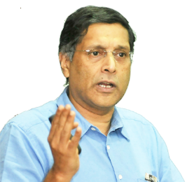
Survey 2017: “RRT” Redistributive Resource Transfer? But for easier understanding I’ll use the word “madad”(मदद/सहायता)
Govt
Rich
IT
Poor
Govt
General States
Special Category
Devolution of “Tax”
Grant in Aid
so, subsidy to poor MINUS indirect tax paid by him = redistribution
What they receive Over and “above” their contribution in GDP..that is “Redistributive Resource Transfer”
Devolution of “Tax”
Grant in Aid
Indirect Tax!

Slide 14
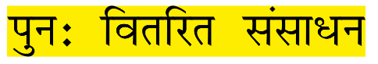
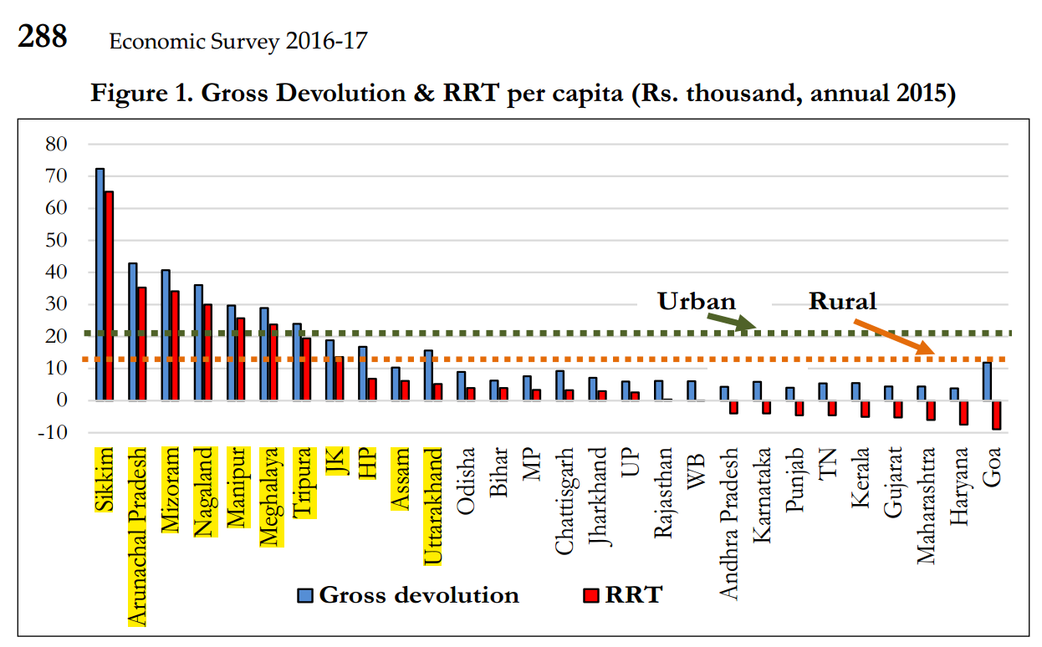
RRT: redistributive resource transfer
$$ redistributed to Poor states
“Rich states”: GDP contribute-> union tax

Slide 15
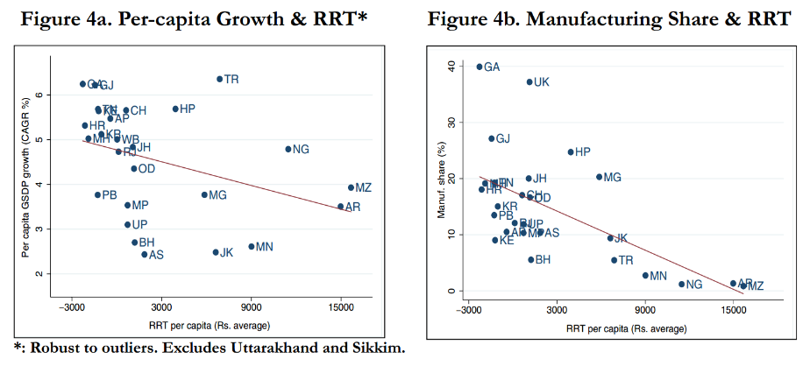
So, has this RRT “aid” helped in their economic growth?
For Decades received so much $$
YET
Poverty Removal, Infrastructure, MFG Base, GSDP… ☹

Slide 16
In fact, more RRT = more pathetic state of affairs = “AID curse”
GSDP growth rate ▼
Mfg Base ▼
State Tax revenue ▼
More RRT Aid
RRT Aid:
lazy & complacent govt
Poor Governance
RRT Aid Curse
“RRT Aid Curse”: Poor State’s Govts. not making effort to improve their economy.
e.g. Guj / MH “Vibrant investor summit”, then why not of J&K?
Guj, MP, Raj, Kerala: tourism branding campaigns- why not NE for so many yrs?

Slide 17
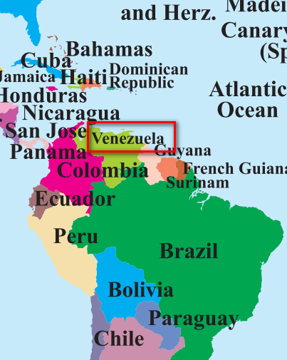
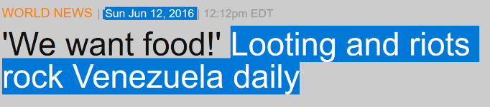
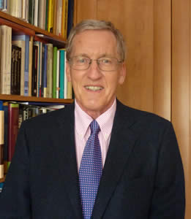
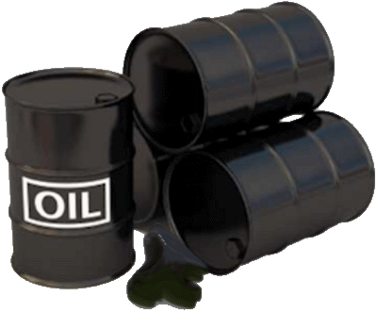
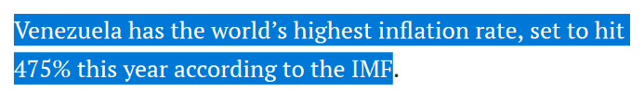
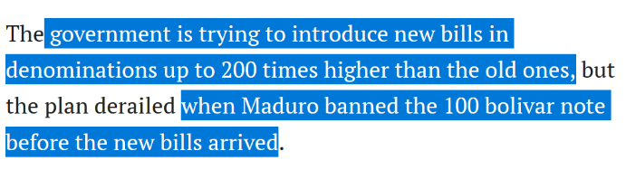
(1993) Economic Geographer Richard Auty: “Resource Curse”
Paradox of Plenty
As such >50k terms in economy and geography,
but since survey mentioned so we’ve to prepare this.
Recall, our demonetization was not like this. Lecture link
#1 among OPEC output

Slide 18
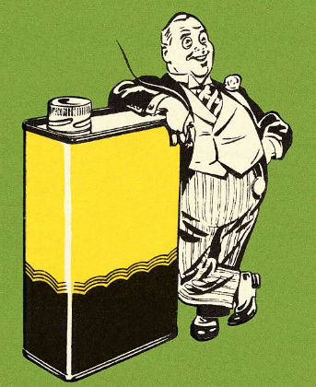
Because survey has mentioned ‘terms’…we’ve to prepare
Dutch Disease
Discovery of Natural Gas, Petrol etc
$$ Inflow
Local currency strong
Non-Energy Exports decline [Agri, textile etc.]->farmer will work in oil-well, food riots
Corruption for license/Contract. “Rent seeking”: in all industry- local and foreign.
“Voracity Effect”
Sudden trade ‘windfall’ (e.g. Oil Export)
Growth declines
“Redistribution” declines (Corruption)
Sharp inflow of Foreign Currency ($) for import and investment► Negative impact

Slide 19
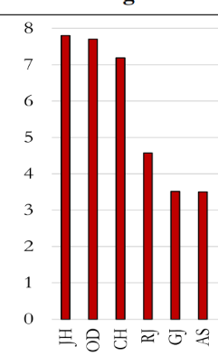
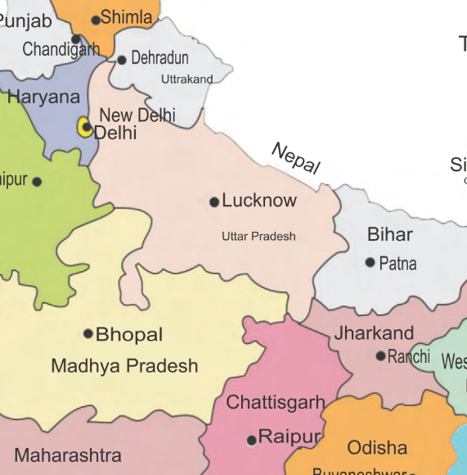
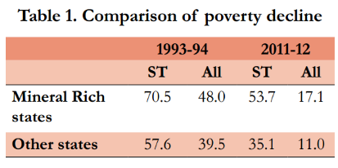
India-2000: “Resource Curse”?
Poor Governance
Resource Curse
Mineral “Bounty”
Per Capita Mineral Wealth..
Still Poverty Decline very low… ☹

Slide 20
Mock Question for Prelims
Which of the following is an example of "Resource curse"?
Venezuela being among top oil exporters, yet suffering from food crisis.
Jharkhand having highest per capita mineral wealth, yet sizable population is poor.
India having a large shale gas reserve, but unable to exploit it on account of fresh-water scarcity.
Answer Choices
a) Only 1 and 2 (b) Only 2 and 3
c) Only 1 and 3 (d) only 3

Slide 21
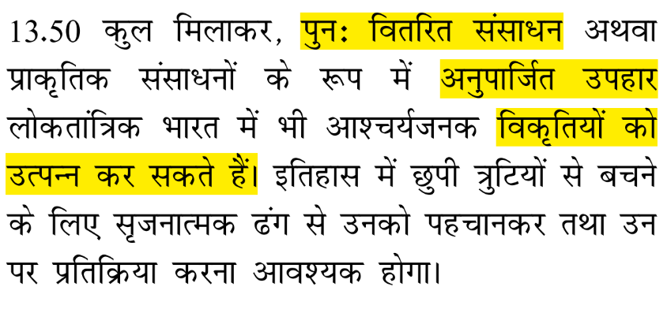
Conclusion of Ch.13: “Bounties (मुफ्त का माल) create Pathologies”
RRT
$ madad: Aid Curse
Mineral Wealth
Resource Curse
Governance ▲: “conditional transfer” (PRI Grant- performance based Ref: 14FC)
Mineral Royalty
Citizen participation: so they get more fruit. Corruption ▼ (District Mineral Foundation-DMF: under Mines Act 2015)
Infrastructure: Soft & Hard
Financial Inclusion, UBI?
Separate Permanent Fund from Mining (SC on Goa Iron Ore), even Texas and others have
Anyways, that’s the story better left for mains

Slide 22
BES172: Survey Chapters related to Subsidies, Grants, and Planning
15 pages: 10 slides (self study for Mains)
as such, these chapters written with Mains flavor but need to have an overview, for Prelims: assertion-reasoning, cause-consequence, definition type MCQs.

Slide 23
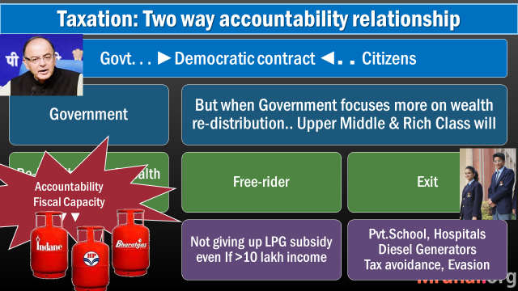
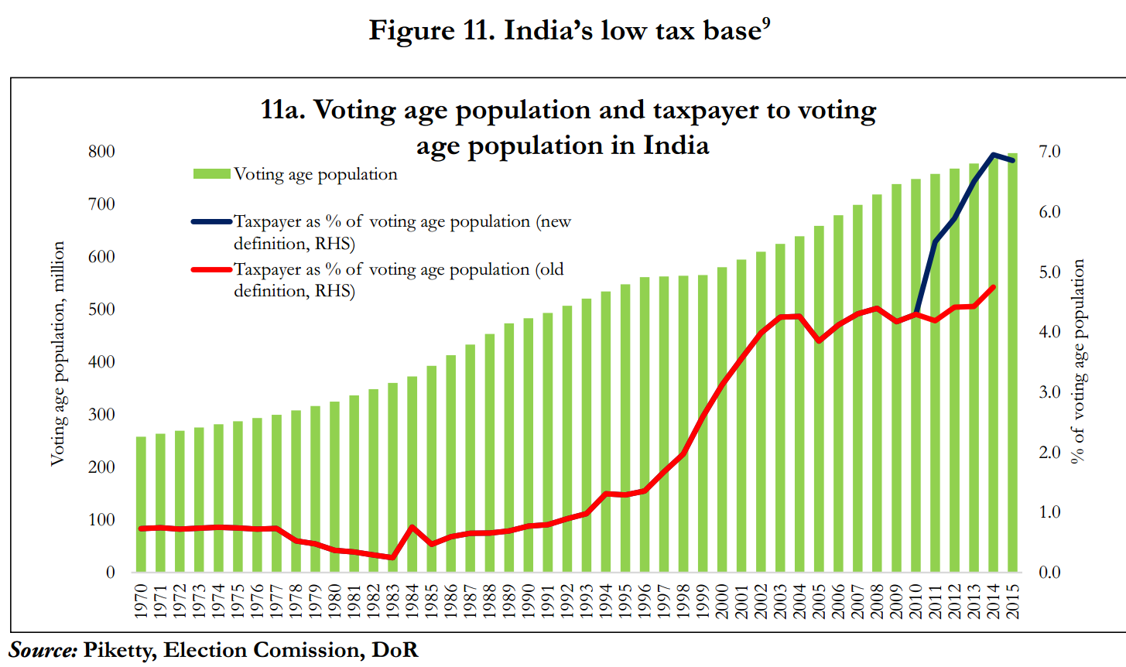
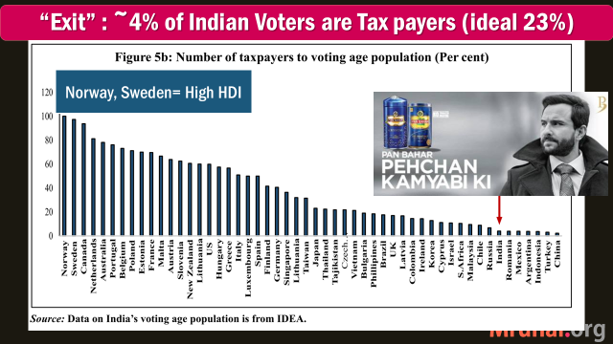
In last year survey: “Fiscal capacity: self study for Mains”

Slide 24
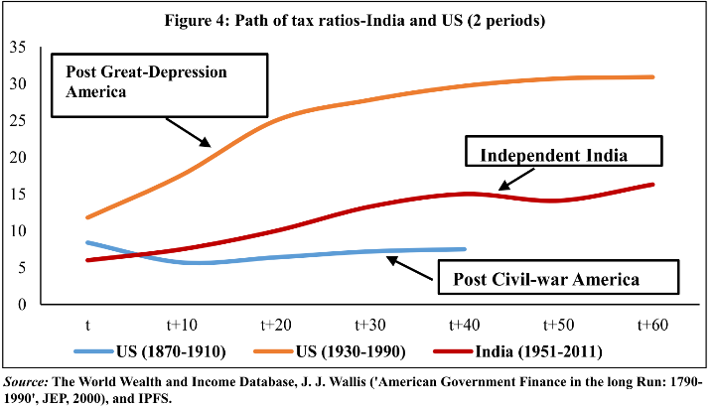
In last year survey: “Fiscal capacity: self study for Mains”
States first roll-out public services, then begin taxations to gain legitimacy.
US-UK forced to raise fiscal capacity during Wars, Economic-Depression
India not gone through this path

Slide 25
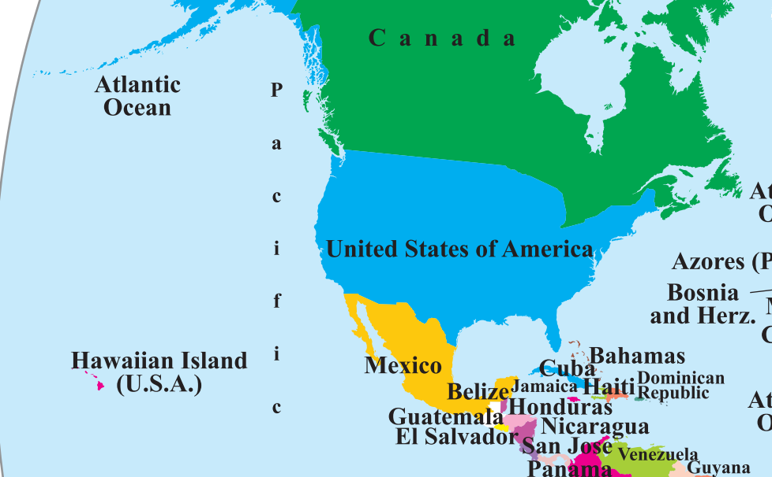
New survey, again: USA: Post Independence
Voting rights narrow: women, minorities not allowed, initially.
Voting rights with Plantation owners, Oil Tycoon, Gold Miners, Rail Road Company owners etc.
Economic Vision: “Free market”, Pro-Capitalism..flag-bearer
Washington Consensus [‘89]
Open Capital (FDI)
By IMF, World Bank & USA
Open Trade (Tax, License)
Reliance on private Sector
Notes:
Wars: Forced to raise Fiscal Capacity…

Slide 26
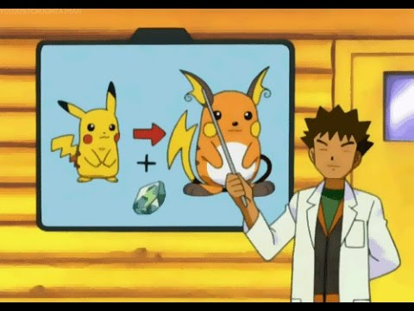
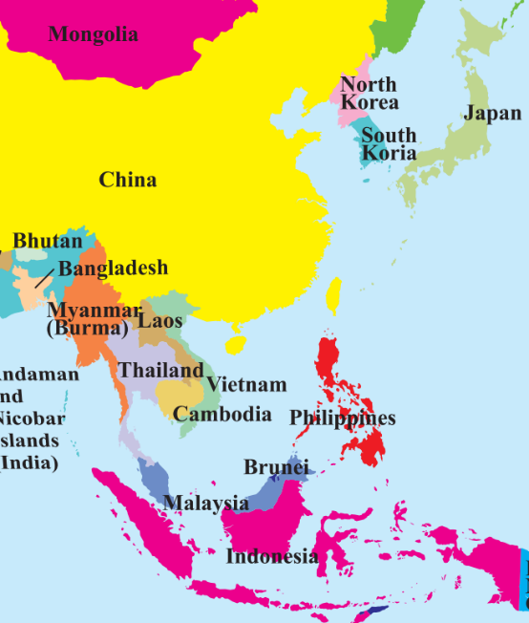
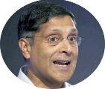
Post Independence: East Asian Economies : followed “Washington Consensus” from 80s and 90s.
China : One Party Communist Rule, but Deng Xiaoping [80s: VAT, FDI]
Indonesia: individual dictatorship [Sukarno]
Singapore, Thailand, Taiwan :De jure Democracy but de facto Authoritarianism:
Voting rights: absent or “de-jure”.
Enforce plans & policies without opposition (or local theHindu’s criticism).
These countries didn't adopt democracy, yet their Pokémons evolved. Only India is like “Pikachu”, that it's not evolving into "Raichu“ ☹.

Slide 27
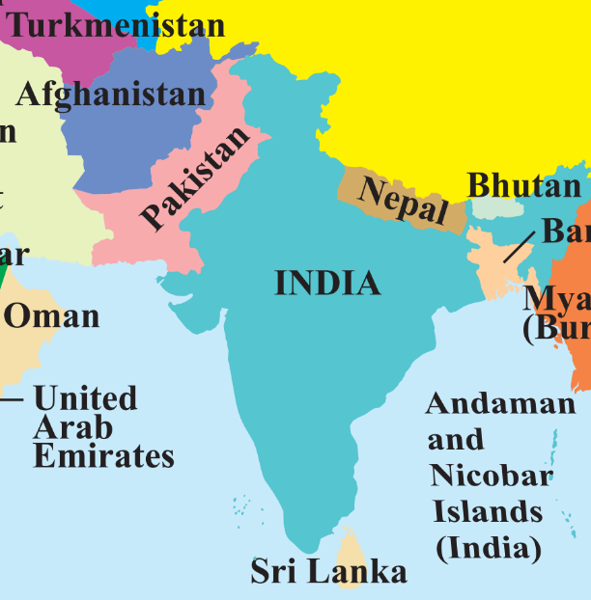
Post Independence, India adopted Democracy BUT…
Precocious (Premature)
Fiscal Capacity, Tax Base ..not much.
Voting rights to all = have to appease all.
So, middle class either
“Free rider” (PDS) or “EXIT” (to private schools, from tax net)
Economic Success: 2 models
Authoritarianism
East Asia
Democracy:
Limited voting rights initially like USA

Slide 28
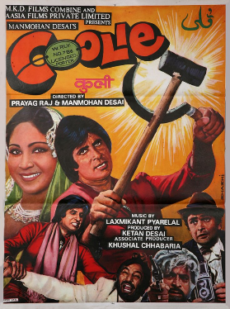
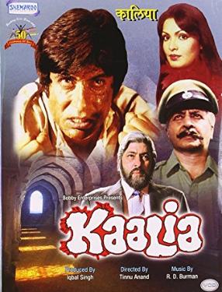
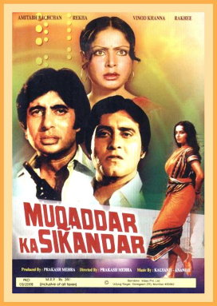
Free India was Poor India (Per Capita GDP $617) hence..
movie plots and Voters’ opinions :
Industrialist = Evil
Poor= Honest
And since we gave voting rights to all. therefore

Slide 29
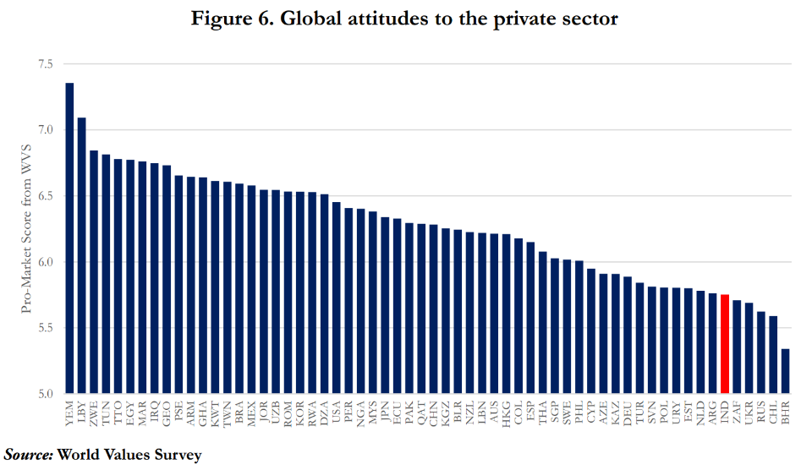

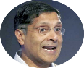
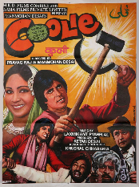

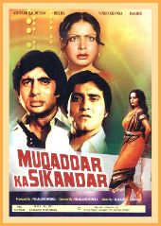
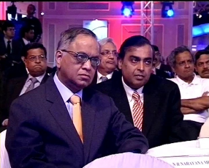
Indian “State” also has “Ambivalence” [Mixed feelings] about private sector, profitability and property rights
Indian people have ‘anti-private sector sentiment, even with so much private sector led growth and muft ka 4g ☹

Slide 30
Free India was Poor India (Per Capita GDP $617) hence..
“Cleaved” (divided) India
Public sector
Private sector
Policy making: Distrust for private sector
Socialism and Mixed Economy
Air India, PSB: Even Inefficient, we oppose privatization / Merger.
USSR: FYP and abolished private sector
India: FYP but did not abolish private sector. Tried to control via license-quota-inspector Raj= ‘91 crisis.
Started PSU, even where private was fit (HMT watches, Hindustan Photo Film- finally winded off.)
APMC: Oppose Corporates/ Wallmart to buy directly; Opposition to Monsanto GM-Seeds
Fertilizer: won’t shut down Loss maker plants but give them more subsidy <Chakravyuh Challenge>
Demonetization, attempt to ‘redistribute’..but other vision also required, else “EXIT”

Slide 31
Free India was Poor India (Per Capita GDP $617) hence..
“Cleaved” (divided) India
Public sector
Private sector
CSS [because voting rights to all ]
But no aadhar, JAM, DBT-> leakages. “Targeted PDS” we only coined in 90s.
EXIT
Middle Class. Bad quality of service in public hospital, schools etc.
Then feels ‘moral right’ to evade / avoid taxes.
Institutional accountability ▼
Demonetization, attempt to ‘redistribute’..
but other vision also required.
“Cleaved” (Divided) India
Poor
Middle & Rich

Slide 32
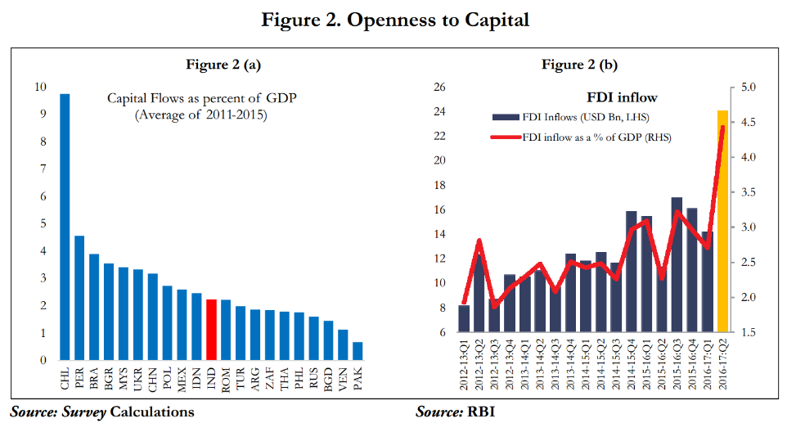
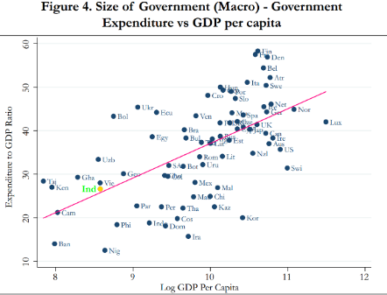

But India’s not a bogus country, we’re now “normal” emerging market Economy
Washington Consensus
Open Capital (FDI)
Open Trade (Tax, License)
Reliance on private Sector
Notes:
Shrinking Size of Government|PSU= India’s emerging economy.

Slide 33


Planning Commission vs NITI Ayog (SELF STUDY)
Textile
Prof. Ramesh Chand
CEO Amitabh Kant (IAS)

Slide 34





Self study, IYB Ch. 3 “Polity”-> List of Ministries, Department

Slide 35
Mock Question for Prelims
Which of the following pairs are incorrectly matched?
Department of official language: ministry of communication
Department of border management: ministry of defense
Department of pharmaceuticals: ministry of chemical
Answer Choices
a) Only 1 and 2 (b) Only 2 and 3
c) Only 1 and 3 (d) None of them

Slide 36
DRAFT 3 year agenda (April 2017 launched for “INPUTs”)
15 years “Vision” (PLAN):
469 lakh crores
7 years “Strategy” (PLAN)
3 Action “Agenda” (PLAN)
7 parts
24 chapters
300+ specific action points
12th FY ended on 31st March 2017.
Notes:
sdg 17 goals and 169 targets

Slide 37

3 years Action “DRAFT” AGENDA (Will study for Mains later)
Deficit FY20
Farmers: 2x income by 2022
Job creation, focus on coastal areas, specific jobs,
Urban Development
Regional
FD: 3%
RD: 0.9%
Banking
Reduce prices, title- tenancy- conversion rules
NE, Nhim, Coastal, Desert-Drought prone
Transport, Energy
Infra.
Sick PSU : disinvestment.
Eliminate black carbon 2022
Governance
LPG to all by 2022
Non-agri entities evading income tax
Rule of law: police, judicial reforms
HRD
Education, health, inclusive society
Environment protection
Indradhanush: 70k insufficient.
Remove corporate tax exemptions.
8.2 lakh crore LITIGATION

Slide 38

Budget 2017: TEC Agenda…<can ask in lower exams>
Transform India
Energize India
Governance Quality
Youth, Poor etc.
Clean India
Corruption, Black Money…

Slide 39
BES172: Survey Chapters related to Subsidies, Grants, and Planning
41 pages: ~15 slides (self study for Mains)
as such, these chapters written with Mains flavor but need to have an overview, for Prelims: assertion-reasoning, cause-consequence, definition type MCQs.

Slide 40





1.4L (▲)
5 lakh cr.
DECREASING ORDER
70k (=)
Urea (▼)
NBS (P,K)
3 lakh cr.
2.72 lakh cr.
1.8 lakh cr.
Petroleum : 25k (▼)
LPG>> Kerosene
1.5 lakh cr.
ISS: 15k cr [▲]

Slide 41

1.8 l cr.
9.6 l cr.
BASEL-III recap.
NPA (31/12/16)
Indradhanush: 70k
22%
BPL (2011)
15 l cr.
Value of SBN Notes.
2.7 l cr.
Subsidy in Budget ‘17
2017-18
TOTAL 2.72 lakh crore
Divide by 168 LCr GDP
= 1.6% of GDP
[and FD =3.2%!]

Slide 42



If so many subsidies given then do we have rivers of milk and honey?
Inclusion error
Exclusion Error
Non-poor receiving
Real Poor not receiving (~50%)
Bottom 40% Strata
Even 40% not reaching them
“free rider” (~40%)
Survey 2015
JAM trinity

Slide 43

But how can you spread JAM on everything when everyone doesn’t have Jandhan account with Aadhar Seeding..

Slide 44


Survey 2016: No no, we can’t JAM everything, BAPU required because lack of fin.inclusion, man of the house may misuse.
LPG-JAM
Kerosene-BAPU
Food-BAPU
Fertilizer-either
BAPU: Biometrically authenticated Physical uptake…

Slide 45


Why Universal basic income (UBI)?
Poorest districts receiving less subsidies. Mis-allocation
60% poor getting only 40% of subsidy

Slide 46




Suresh Tendulkar Poverty Estimation Method (2011)
Per person expenditure | Urban | Rural
per month | 1000 | 816
Per year? | 12000 | ~9800
Then let’s just give appropriate amt to them for “spending” And bring them out of poverty line!
You’re below poverty line, IF you’re spending less than this amount..
Notes:
Inflation adjusted.

Slide 47

22% junta BPL (2011)
@ Rs. 0 UBI
More UBI means
More Fiscal Deficit
12% junta BPL if 2k UBI
Rs.12,730/-
per person per year
Then 0% poverty

Slide 48




But we’ve to Control Fiscal Deficit @3% of GDP (FRBM Act)
So have to stop the “EXISTING” Programs
Have to exclude some rich people from UBI

Slide 49



Survey-2016: 1 lakh cr. Going to well-off section of the society
Mostly rich people…
Tax
Excise
Biscuit
6%
Gold jewelry
1-2%
PPF Deposit
Exempt (1.5l/PA)
Interest
Exempt
Withdrawal
Exempt

Slide 50

Survey 2017: “Chetan Bhagat”.LPG, gold “Subsidies” cornered by rich
Survey 2017: stop all these subsidies, we can do UBI without crossing fiscal deficit limits.
Gold subsidy…?
Ordinary goods excise 6-12.5%
Gold jewelry: ~1-2% and mostly rich / welloff people buy it!

Slide 51

Stop existing schemes, subsidies.
Except richest 25%, give UBI ~Rs.2520 per year, BPL: 22%-> 9%
1.6% of GDP [Fiscal Deficit ceiling 3%, because leakages ▼].

Slide 52

Who is the head of the Government?
President
PM
“De Jure” (nominal)
De Facto (infact)
UBI: “universal”
UBI (not for richest 25%)

Slide 53

UBI: De jure universality, de facto quasi universality
“Well-off”
Income tax, bank balance (demonetization-PAN-Aadhar Seeding)
Self Give it up
Rural: automobile, TV-fridge etc assets (but SECC captured data but doubts.)
LPG
Public list
Neighbors, relatives will “Whistleblowing” that Mr.ABC is ‘well-off’.
Self-targeting
Regularly visit govt office with documents and biometric thumbprint: [rich don’t have time, so they’ll “EXIT”]
Gradualism
Widow> Pregnant > women >…
More children- more UBI= overpopulation

Slide 54
Mock Question for Prelims
Economic Survey 2016-17 has proposed which type of universal basic income (UBI) for India?
De facto quasi universal
De jure quasi universal
De facto universal
De jure universal.
Answer choices
a. Only 1 and 2 b. Only 1 and 4
c. Only 2 and 3 d. Only 2 and 4

Slide 55



UBI quasi universality : “EXIT” option from PDS..
Diversion in open market & restaurants
Either PDS
Either UBI
If more “EXIT”-> quota down, shop close
Shopkeeper has to stop diversion.
Notes:
Laddu in any one hand If beneficiary signs for UBI, then no cheap PDS/ fertilizer [reduce quota to Shopkeeper -> out of biz / or Reforms]

Slide 56




Can’t implement @once, but discuss seriously
Pros, Cons, preconditions
41 pages bolbacchan..
2 pages listing only references

Slide 57

UBI: Benefits
MNREGA: skill killer, farm-hand shortage
Accident of birth (SC/ST/rural/Poor)
Accident of life (drought, money lender) vs psychological confidence
PDS: leakage, diversion. Better buy from open market
Safety Net
Deprivation
Destitution

Slide 58
Against UBI
Still EVEN Swiz. Referendum: 77% rejected!
Likely misuse by “men of the house”
JAM no panacea, BAPU req.
Fiscal capacity
GST, FRBM, state consult?
Political feasibility?
NFSA, MDM, MNREGA, PDS? If fail then exit?
Market dynamics not helping. Pulse price!
1st world: tax:GDP
Able bodied men given ‘charity’
Hiding poverty in SECC.
Moral hazard: laziness to work
Notes:
Swiss voters have overwhelmingly rejected a proposal to introduce a guaranteed basic income for all.
Final results from Sunday's referendum showed that nearly 77% opposed the plan, with only 23% backing it.
The proposal had called for adults to be paid an unconditional monthly income, whether they worked or not.
The supporters camp had suggested a monthly income of 2,500 Swiss francs (£1,755; $2,555) for adults and also SFr625 for each child.

Slide 59
Critically assess the feasibility of giving universal basic income (UBI) to Indian poor. 200 words
No Ph.D just summary
Coz next Survey to focus on this!
Introduction
Pro
Define
Con
Conclusion
Favour
Against
Body
Origin
Data

Slide 60


UBI: introduction: define
UBI means government depositing a specific sum of money, beneficiary’s account each year.
to augment his/her purchasing power
in open market.
Not as ‘salary’, or ‘pension’

Slide 61

Conclusion: UBI favour
UBI can play potential role
in eliminating poverty and
providing safety net
against deprivation and destitution.
However, in the light of aforementioned challenges (last slide),
UBI should be designed & implemented
in a manner that minimizes leakage &
doesn't put heavy burden on fiscal resources.
Q. Assess feasibility
Ans. Conclusion “Finding” yes / no

Slide 62

Conclusion: UBI against
UBI can play potential role
in eliminating poverty and
providing safety net
against deprivation and destitution.
but conditions are not yet ripe for its introduction in India.
Q. Assess feasibility
Ans. Conclusion “Finding” yes / no

Slide 63
BES172: Survey Chapters related to Subsidies, Grants, and Planning
as such, these chapters written with Mains flavor but need to have an overview, for Prelims: assertion-reasoning, cause-consequence, definition type MCQs.

Slide 64


नाचो रे..
50%
Survey is over
And remaining
Chapters are
Mostly
bol-bachchan
*some minor topics remain, BES 17”4”

Slide 65




Old content also “demonetized”
But watch that playlist for
7th PC, 14th FC, Budget merger

Slide 66


Economy: 6 pillars + theory + current + BES17 (pre cum Mains)
1.Banking, Fin, Insur.
6.HRD
2.Budget
3.BoP
4.Sectors
5.Infra
V1:c3,4
V1:c2,3, 6,9,11(GST),13
V1c:5
V1c:7,11(Agri)
V1c:10
v1c:12, 14; Budget^Rail

